Slide 1
EduVision-WiTrack: Secure Attendance with Visual Lock
CSE7101- Capstone Project
Review-5
Batch Number: IST_4
Under the Supervision of,
Dr.Poornima S
Assistant Professor
School of Computer Science and Engineering
Presidency University
Roll Number | Student Name
20221IST0023 | G DHANUSH
20221IST0004 | ANOOP KUMAR
20221IST0006 | NAVYA B
Name of the Program: Information Science and Technology
Name of the HoD: Dr. Pallavi R
Name of the Program Project Coordinator: Ms. Benitha Christinal J
Name of the School Project Coordinators: Dr. Sampath A K , Dr. Geetha A

Slide 2
Content
Problem Statement
Objectives
System Architecture Diagram
Analysis of Problem Statement
SDGs
Future Scope
Output
Conclusion
Github Link

Slide 3
Problem Statement Number: 582
Problem Description
Traditional attendance systems are slow, easy to manipulate, and allow proxy attendance. Basic Wi-Fi–based attendance marks students present just by detecting their device, even if they are outside the classroom. This creates a major security problem.
To solve this, there is a need for a secure system that can verify both device connection and physical presence. The proposed solution combines Wi-Fi IP detection with a real-time camera headcount to ensure attendance is marked only when both match, preventing proxy and improving accuracy.

Slide 4
Objectives
To develop a secure attendance system using Wi-Fi IP detection and real-time camera validation.
To prevent proxy attendance by matching connected device count with actual student headcount.
To automate attendance marking and reduce manual effort and human errors.
To utilize existing campus Wi-Fi and low-cost camera hardware for an affordable solution.
To ensure accurate, fast, and reliable attendance recording for classrooms.

Slide 5
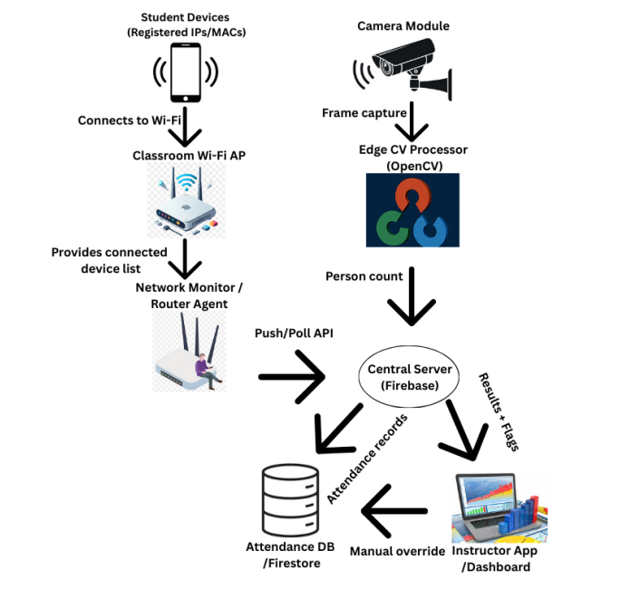
System Architecture Diagram

Slide 6
Analysis of Problem Statement
Traditional attendance methods fail to ensure accuracy and are vulnerable to manipulation, especially through proxy attendance. Basic Wi-Fi–based systems only verify a device’s connection, not the student’s physical presence, making them easy to exploit. Camera-only or biometric systems require costly hardware and may raise privacy concerns.
Hence, the core problem is the lack of a secure, dual-verification mechanism that confirms both the student's physical presence and authenticated device connection. A combined Wi-Fi and camera-based approach effectively addresses this gap by ensuring attendance is marked only when both validations match.

Slide 7
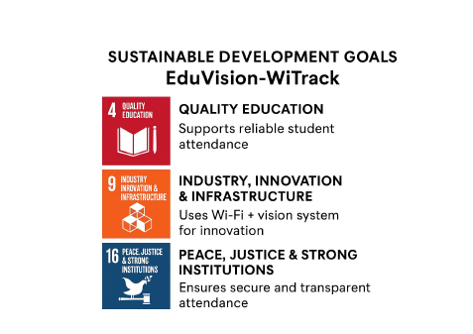
SDGs
SDG 4 – Quality Education
SDG 9 – Industry, Innovation & Infrastructure
SDG 16 – Peace, Justice & Strong Institutions

Slide 8
Future Scope
Integration of face recognition to identify individual students automatically.
Expansion of the system for large halls using multiple synchronized cameras.
Addition of GPS/location verification for outdoor or seminar-based attendance.
Development of a mobile app for real-time alerts, analytics, and instructor controls.
Use of AI models to improve headcount accuracy and detect unusual attendance patterns.

Slide 9
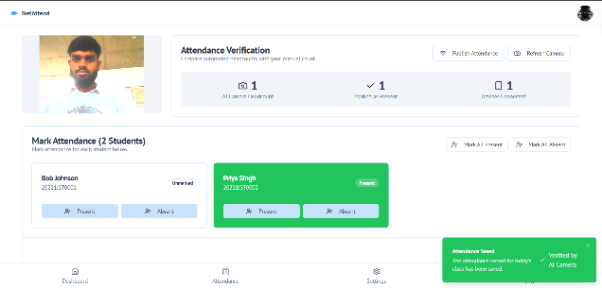
Output
Situation 1: There are 1 pupils in the class, and every registered gadget is linked to the Wi-Fi. Twenty students were counted by the camera. All 1 of the students were correctly marked by the system.

Slide 10
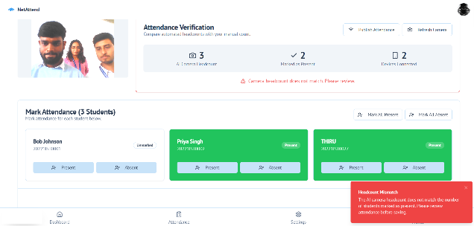
Output
Situation 2: Attendance of Proxy Try. From outside the classroom network, a student's device was linked. Although the IP address was identified, there were 2 pupils with cameras and 3 connected devices. By accurately detecting the disparity and flagging the attendance as invalid, the system stopped fraudulent marking.

Slide 11
Conclusion
A unique Wi-Fi and camera-based smart attendance monitoring system that overcomes the serious security vulnerabilities of single-factor solutions was successfully created and tested in this study. The system offers a strong defense against proxy attendance fraud by putting in place a dual-validation mechanism that compares the number of authenticated IP addresses on the network with a real-time, camera-based occupant headcount.
The methodology's main goals were accomplished by:
Mitigating Fraud: Showing that the dual-check logic is successful in guaranteeing both digital and physical presence, 100% fraud detection was achieved in tested proxy scenarios.
Assuring Feasibility: Verifying that a high-security automated system can be implemented with affordable and easily accessible infrastructure, such as the campus's current Wi-Fi and widely used computer vision libraries.
By effectively automating the time-consuming attendance process and providing extra features like a location-based fallback for connectivity problems, efficiency can be increased.

Slide 12
Github Link
https://github.com/ANOOPKUMAAR/7IST01

Slide 13


